Slide 1
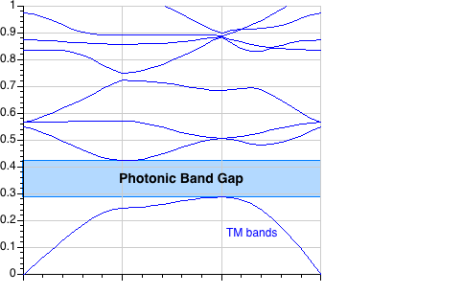
2d periodicity, ε=12:1
a
frequency ω (2πc/a) = a / λ
irreducible Brillouin zone
Γ
X
M
Γ
M
k
E
TM
gap for
n > ~1.75:1
Γ
X
H

Slide 2
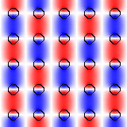
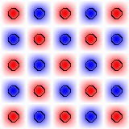
2d periodicity, ε=12:1
E_{z}
(+ 90° rotated version)
E_{z}
Γ
X
M
Γ
E
gap for
n > ~1.75:1
TM
–
+
H
min–max theorem: 1st band “wants” to concentrate in high ε, higher bands forced out by orthogonality

Slide 3
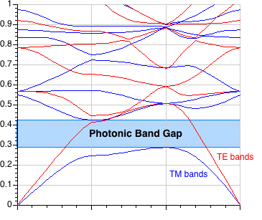
2d periodicity, ε=12:1: TM gap, no TE gap
a
frequency ω (2πc/a) = a / λ
irreducible Brillouin zone
Γ
X
M
Γ
M
k
E
E
X
TM
TE
Γ
H
H

Slide 4
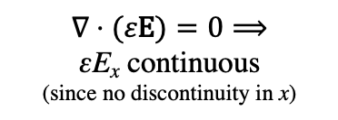
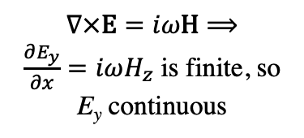
What a difference a boundary condition makes…
y
x
ε₁
ε₂
$$∇×\text{E}=iω\text{H}⟹$$
$\frac{∂E_{y}}{∂x}=iωH_{z}$ is finite, so E_{y} continuous
E|| is continuous:
energy density ε|E|²
more in larger ε
E_{1,||} = E_{2,||}
εE⊥ is continuous:
energy density |εE|²/ε
more in smaller ε
$$∇⋅(ε\text{E})=0⟹$$
εE_{x} continuous
(since no discontinuity in x)
ε₁E_{1,⊥} = ε₂E_{2,⊥}
To get strong confinement & gaps,
want E mostly parallel to interfaces
TM: ||
TE: ⊥

Slide 5
2d photonic crystal: TE gap, ε=12:1
(C_{6v} symmetry of hexagon)
Origin of TE gap: 1st band’s
TE (E_{x},E_{y}) electric field lines
can “loop around” cylinders
triangular / hexagonal lattice of air holes in ε=12
TE bands
TM bands
K
K
E
(C_{6v})
M
TE
(C_{3v})
1st Brillouin zone
+ irreducible B.Z.
H
gap for n > ~1.4:1

Slide 6
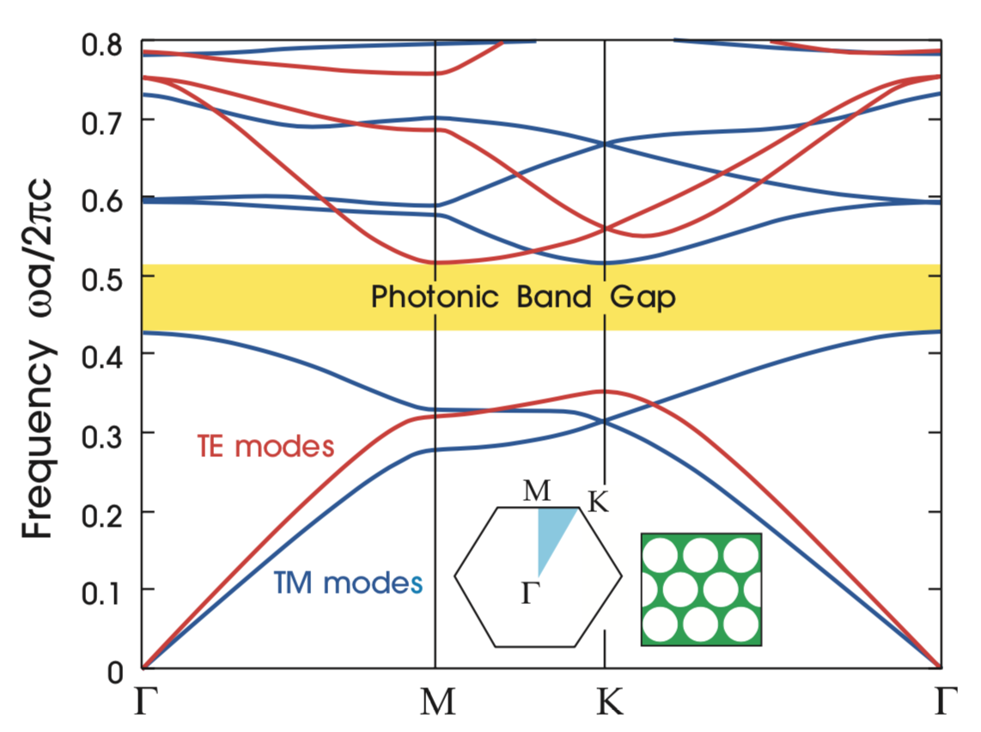
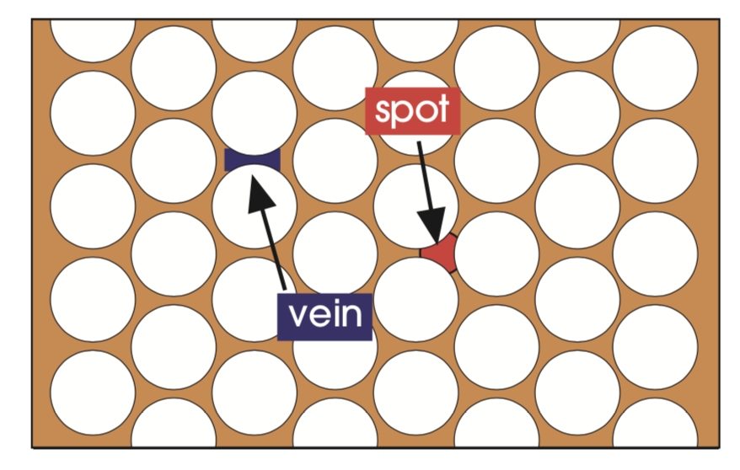
“Complete” overlapping TE+TM gap
TE+TM
TE gap: 1st band loops around veins, 2nd band forced out by orthogonality.
TM gap: 1st two bands concentrated in interstitial “spots,” 3rd band forced out by orthogonality.
(In 2d, however, we can generally choose one polarization to work with, so an overlapping TE+TM gap is rarely needed. In 3d, though, modes are no longer purely polarized and we will have to handle every field orientation simultaneously.)

Slide 7
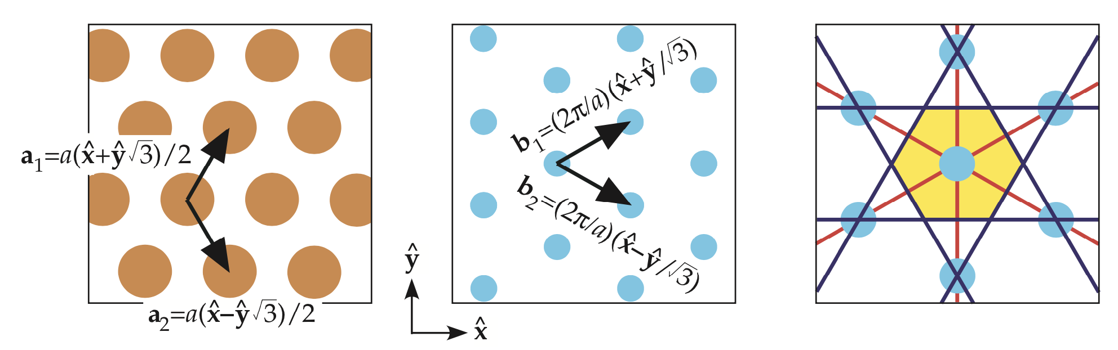
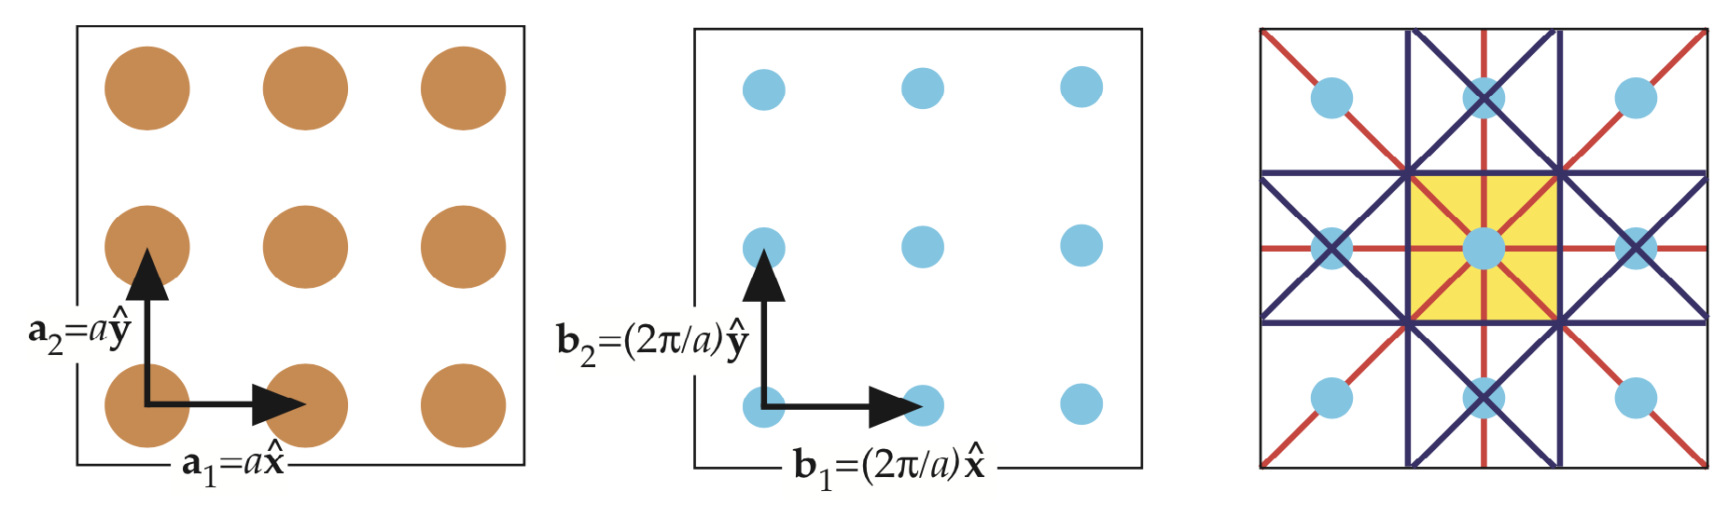
Brillouin zones: A better unit cell in k
hexagonal / “triangular” Bravais lattice
Reciprocal lattice
first Brillouin zone
primitive
cell?
• Problem: obvious “primitive cell” in k space breaks C_{6v} symmetry.
• Solution: define “first Brillouin zone” as points closer to k=0
than to any other reciprocal lattice vector G.
(also called “Wigner–Seitz cell” of Bravais lattice,
or “Voronoi cell for any set of points.)
gives square B.Z.
in square lattice:

Slide 8
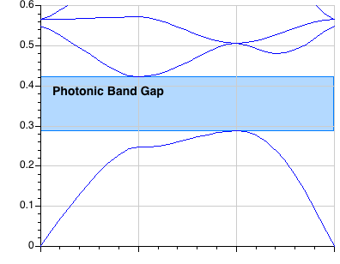
Single-Mode Cavity “point” defect: break all translation symmetry = localized modes in gap
reduced radius ~ reduced ε
~ higher ω
Bulk Crystal Band Diagram
(this is a cartoon:
k is not conserved)
frequency (c/a)
A point defect
can push up
a single mode
from the band edge
Γ
X
M
Γ
M
X
(k not conserved)
recall Taylor expansion around M
= analytic continuation in gap: k = M + i(decay)
Γ

Slide 9
“Single”-Mode Cavity
Bulk Crystal Band Diagram
frequency (c/a)
A point defect
can pull down
a “single” mode
…here, doubly-degenerate
(two states at same ω)
Γ
X
M
Γ
rotation of X = Y
M
X
(k not conserved)
Γ

Slide 10
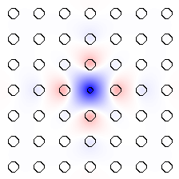
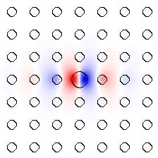
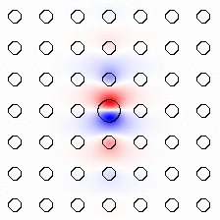
Tunable Cavity Modes
frequency (c/a)
E_{z}:
monopole
dipole

Slide 11
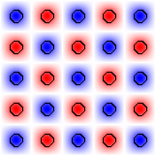
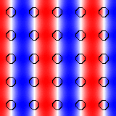
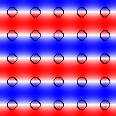
Tunable Cavity Modes
band #1 at M
band #2 at X’s
from M
from X
from Y
≈ multiply by exponential decay
E_{z}:
monopole
dipole

Slide 12
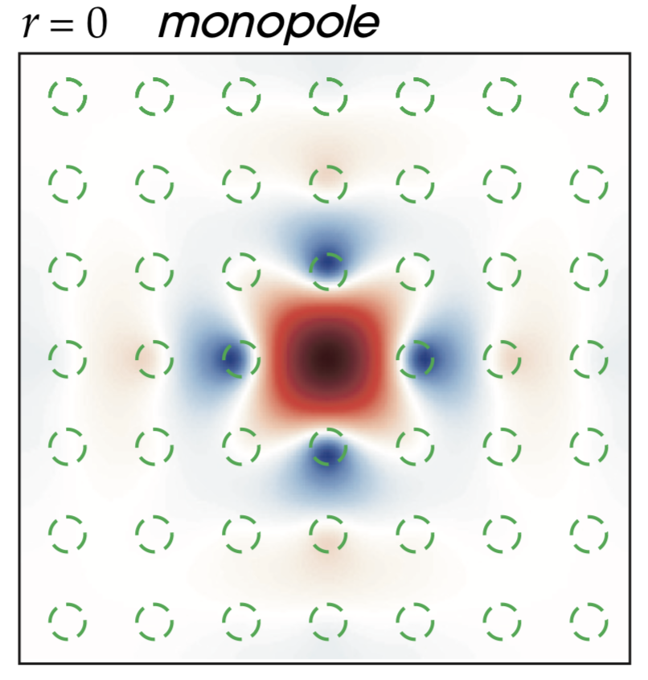
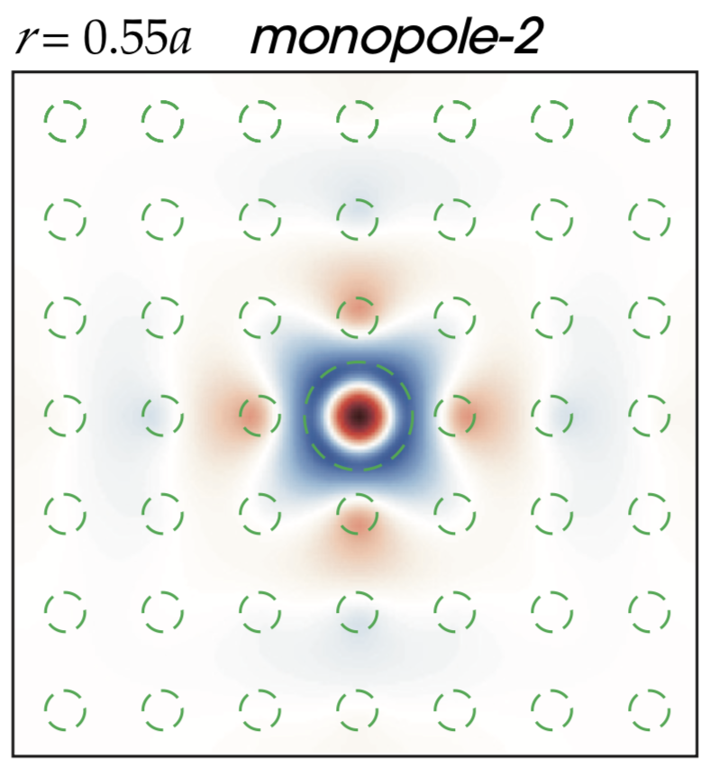
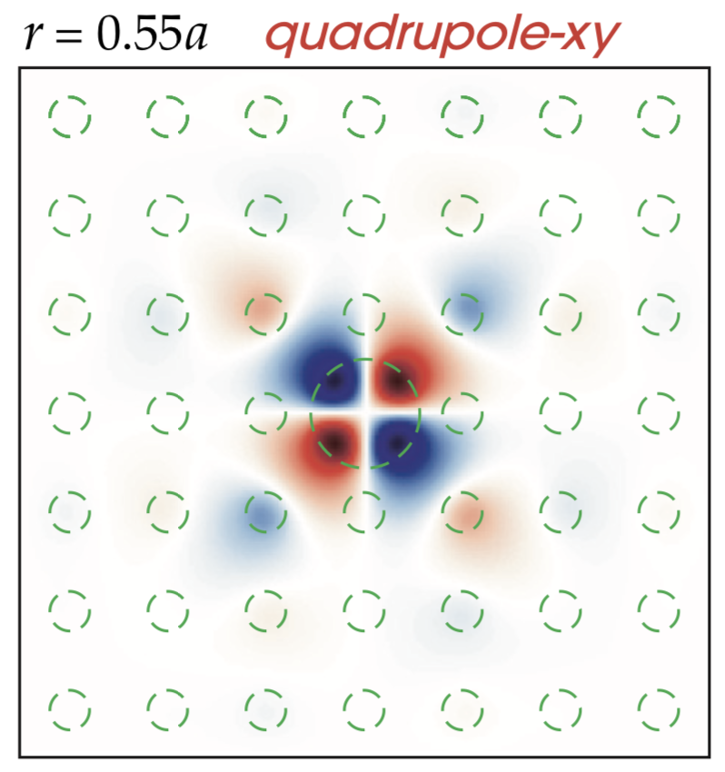
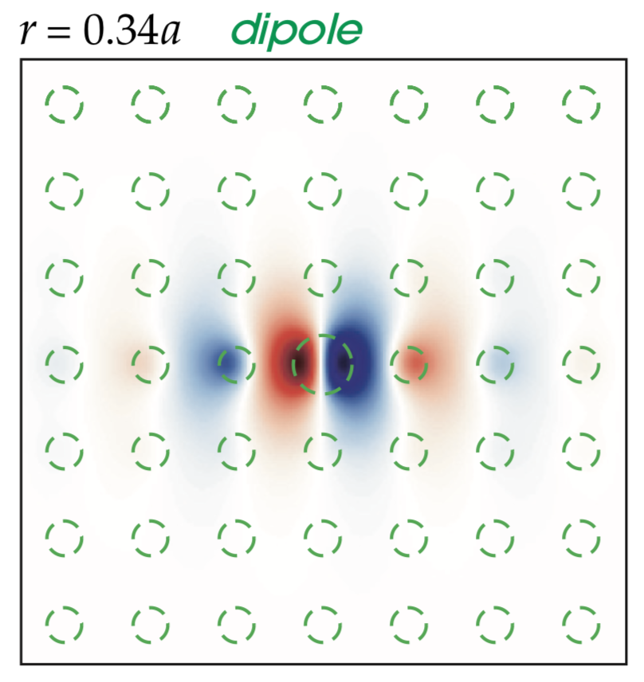
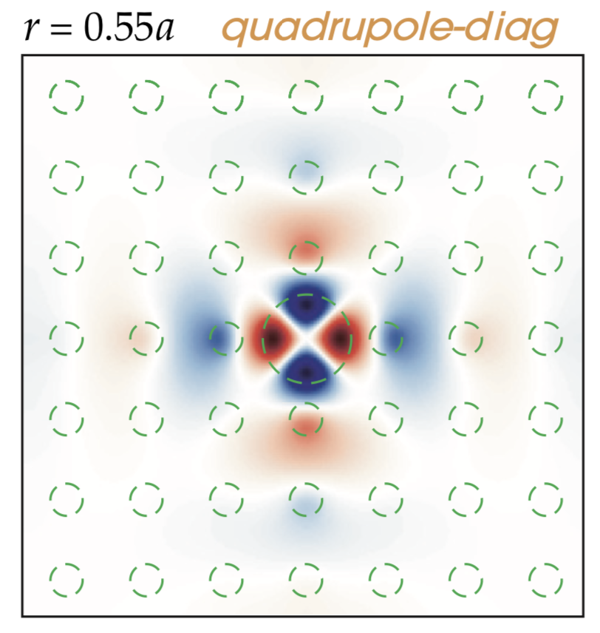
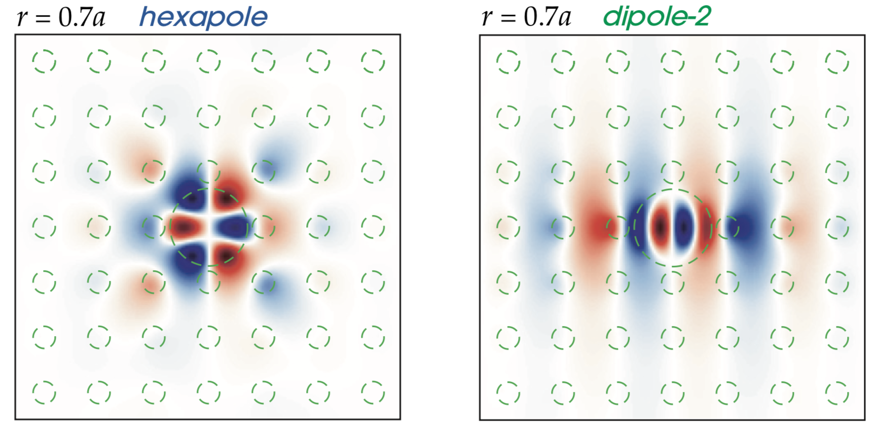
Other defects = other C_{4v} irreps
 | E | 2C₄ | C₂ | 2σ | 2σ′
Γ₁ | 1 | 1 | 1 | 1 | 1
Γ₂ | 1 | 1 | 1 | -1 | -1
Γ₃ | 1 | -1 | 1 | 1 | -1
Γ₄ | 1 | -1 | 1 | -1 | 1
Γ₅ | 2 | 0 | -2 | 0 | 0
Γ₁
Γ₅
(doubly
degenerate)
Γ₃
Γ₄

Slide 13
Intentional “defects” are good
microcavities
waveguides (“wires”)

Slide 14
Projected Band Diagrams
1d periodicity
M
X
not conserved
Γ
conserved k!
conserved
So, plot ω vs. k_{x} only…project Brillouin zone onto Γ–X:
gives continuum of bulk states + discrete guided band(s)

Slide 15
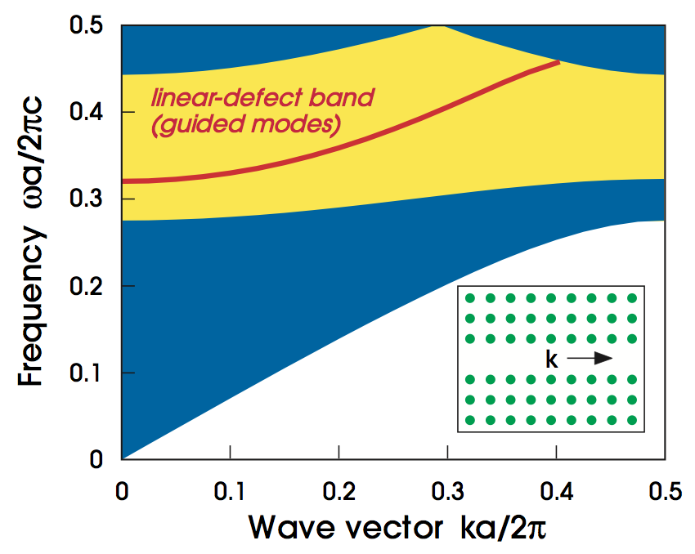
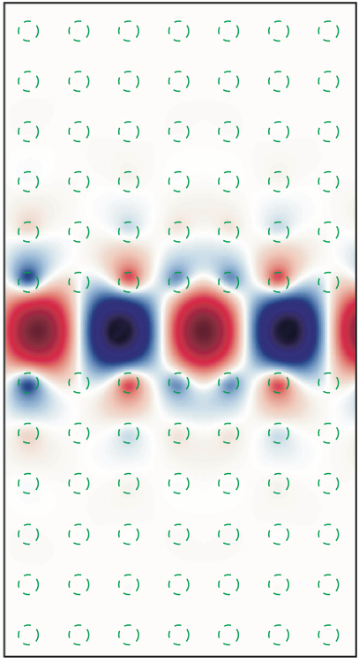
Air-waveguide Band Diagram
continuum of
bulk-crystal modes
any state in the gap cannot couple to bulk crystal ⇒ localized

Slide 16
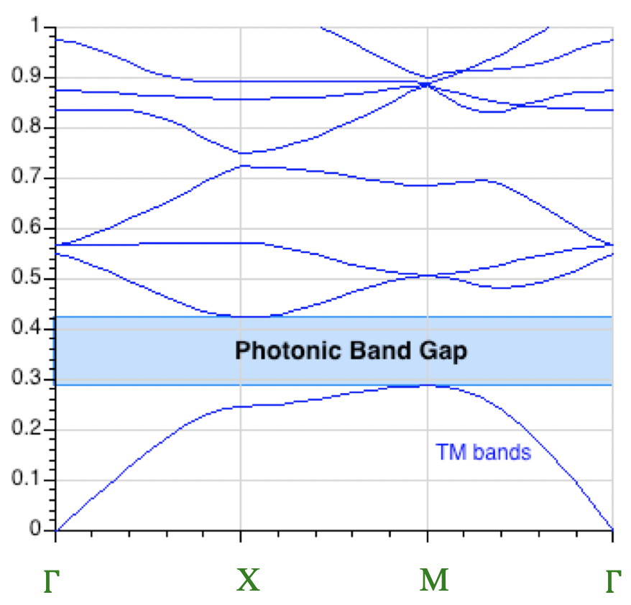
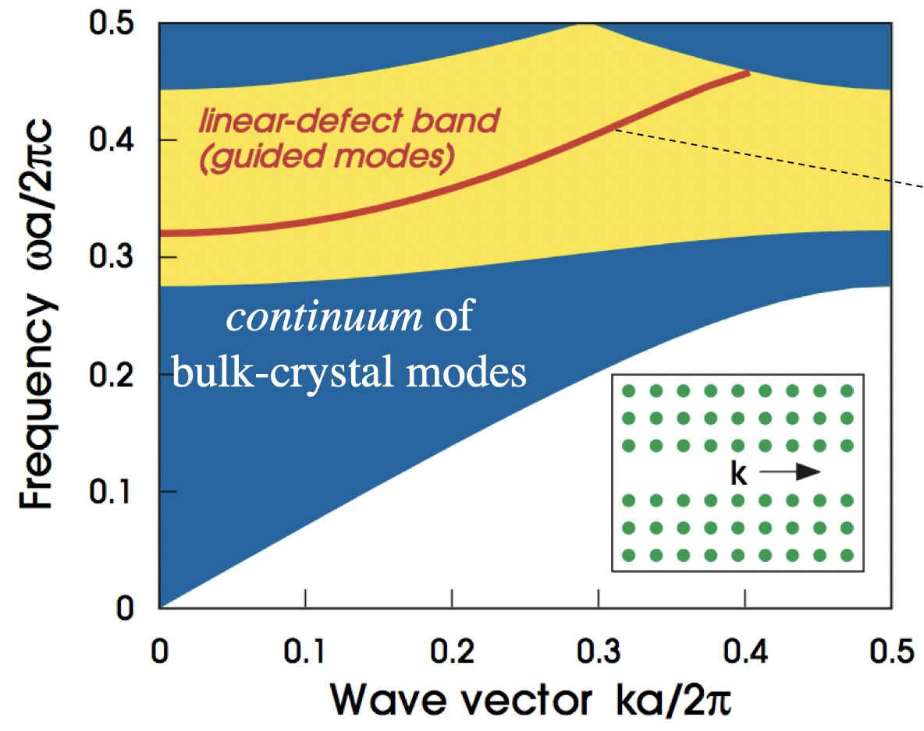
Projected band diagram: k_{x} conserved
plot all bands vs. k_{x}
gap
M
X
X
Y
M
Γ
Γ
X

Slide 17
(Waveguides don’t really need a complete gap)
Fabry-Perot waveguide:
This is exploited e.g. for photonic-crystal fibers…

Slide 18
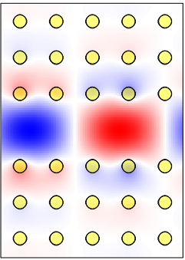
Guiding Light in Air!
mechanism is gap only
vs. standard optical fiber:
“total internal reflection”
— requires higher-index core
no hollow core!
hollow = lower absorption, lower nonlinearities, higher power

Slide 19
Review: Why no scattering?
forbidden by Bloch
(k conserved)
forbidden by gap
(except for finite-crystal tunneling)

Slide 20
Benefits of a complete gap…
broken symmetry –> reflections only
effectively one-dimensional

Slide 21
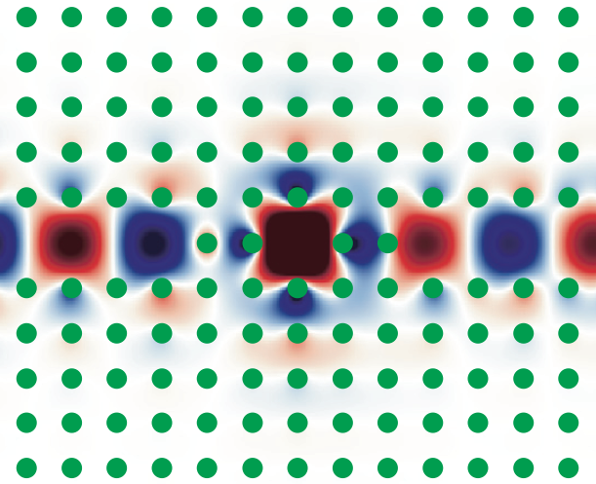
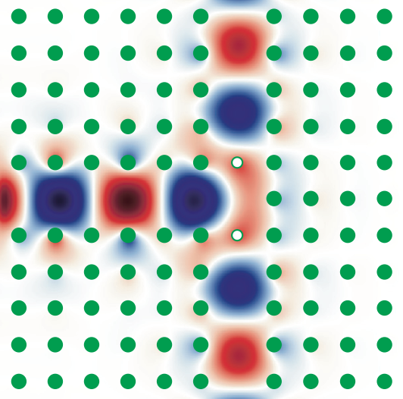
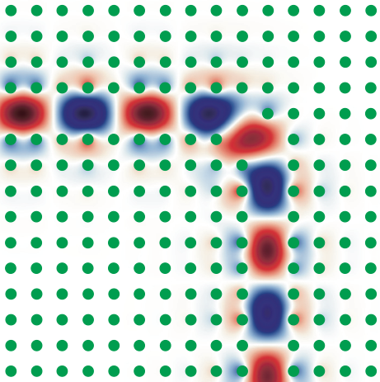
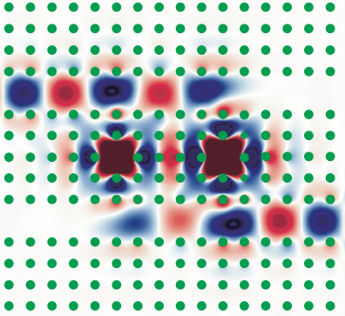
“1d” Waveguides + Cavities = Devices
resonant filters
waveguide splitters
high-transmission
sharp bends
channel-drop filters

Slide 22
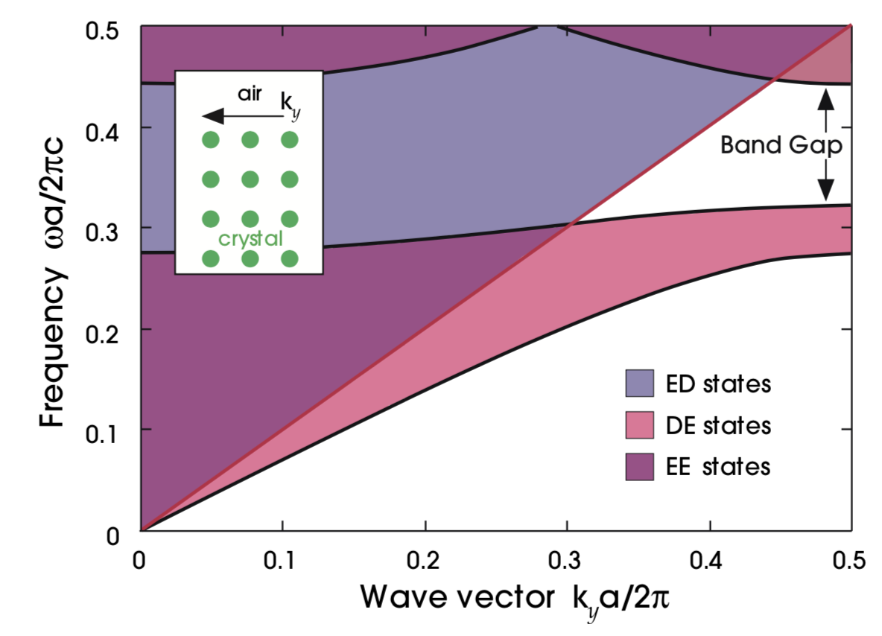
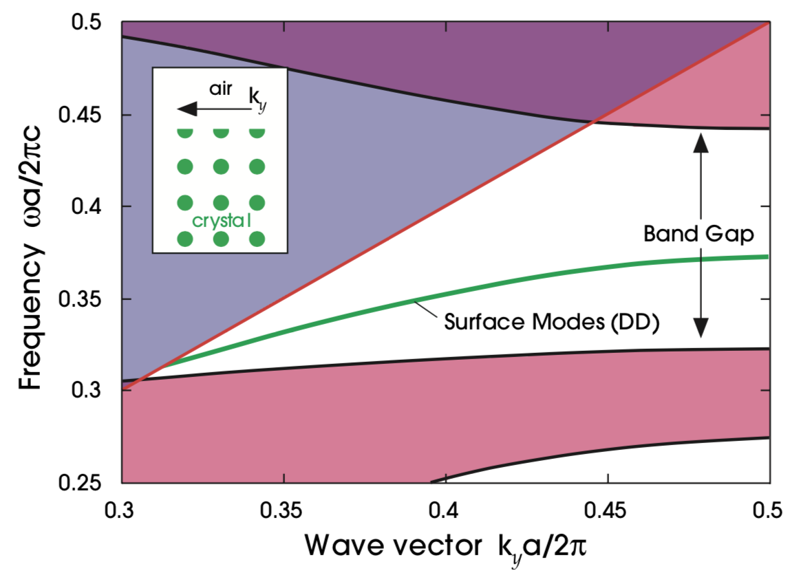
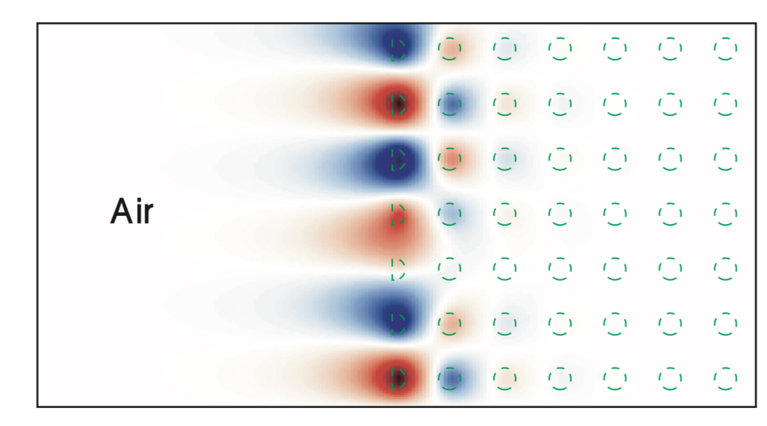
Surface states in 2d
Projected band diagram: only k|| conserved: Plot projected crystal bands + light cone.
Surface termination determines surface state solution: see effect of 2 different terminations!

